Slide 1
NER VISION 2047
Presented before Secretary,
Ministry of Development of North Eastern Region,
Government of India
12 August 2024

Slide 2
Framework of sectoral visions: Quadrilateral Approaches
I. Brief Background
II. Present status
Where does the NE Region stand : National and global comparison
Laggard syndrome : Why and what the NER lack
Institutional drawbacks
Governance dynamics
Limits of resources, skills and capacities
Geography and Connectivity
Markets, Technology and infrastructures

Slide 3
Framework Contd.
III. Possibilities, Potentials and Promises
Quantitative targets
Qualitative targets
Potentials and Possibilities
Formidable challenges and possible pull factors
Benefits of achieving the vision targets
Cost of not doing/reaching the targets

Slide 4
Framework Contd.
IV. Strategic Moves and Policy Interventions to achieve the 2047 vision goals
What strategic thinking ? Critical Policy intervention Physical infrastructures Technological inputs Institutional Support Legal-constitutional linkages | Finance and Resources Mobilisation Cross border interconnections Cross NER interconnections Governance reorientation and restructuring Centre-State dynamics Role of multilateral and bilateral agencies

Slide 5
Methodology : Nine Layer Consultations
Literature Survey : Use of Proven Tools to prepare Vision
Experts Contributions
Consultations with the policy makers both National and State Level
Consultations with the professional institutions
Consultations with the private sector/market influencers
Consultation with the Entrepreneurs/women and youth organisations
Consultation with the multilateral and bilateral agencies
Consultations with the ciivl society, community leaders and NGOs
Consultations with cross border stake holders

Slide 6
Why Vision 2047 Document ?
Global, National and regional contexts have undergone steady changes
Aspirations, Expectations and Standards have risen: 100 years of Independence
India’s global standings and competitive dynamics to be matched by domestic consolidation: NER emerging to be a key actor
Circumstances and determinants have changed
Landscape for actions and projects have become much wider
New Generation of actors, institutions and instruments
Emergence of New Challenges and diverse threats
The conflicts and instabilities have been broadly sidelined by mainstreaming of development, peace and stability aspirations

Slide 7
TRANSFORMATIVE GOALS
#1 NER as South Asian Power Pool
OVERARCHING GOALS :
NORTH EAST REGION AS
New Growth Pole of India and Eastern South Asia (Bangladesh, Bhutan, Myanmar, Nepal and North East Region) also known as NER Growth Quadrangle (NERGQ) as a significant player in India’s Act East Policy, Viksit Bharat and Aatmanirbhar Bharat 2047
#2 Border as Opportunity
#3 NER as Green Destination
#4 North East Economic Corridor
#5 NER as Citadel of Climate Studies
#6 NER as a Medical & Adventure Tourism Destination
#7 NER a Soft Power Reservoir: Youth, Sports and Music
#8 The Peace Dividend

Slide 8
CRITICAL DETERMINANTS AND COMPONENTS OF NEW GROWTH POLE
Strategic Layout
I Borders as Opportunity (Explained separately)
II 4 x4 Connectivity Matrix
Four ways connectivity Matrix:
Within a State (Assam)
Between the two states (Assam and Arunachal Pradesh)
States (NER) with the rest of India
States (NER) with the neighbouring countries
Four instruments of connectivity
Roadways; Railways; Airways; Waterways
.
6 Key Actors
Centre : Ministries
States : Departments
Multilateral/bilateral Agencies
Private Sector
Communities/INGOs/NGOs
Cross border actors and institutions

Slide 9
III. Reverse Integration
Orthodox model of expecting, enticing and engaging the NER joining the rest of India not able to deliver expected outcomes
Reverse model : Vital and Far Reaching
Several Regional and Global Examples : Reverse models tested and remain successful
China : reverse integration : entire sub-regional landscape of
South West including Sichuan, Tibet, Yunnan, Xinjiang and Qinghai
After it developed the coastal best in South East region.
Nation state went there in these relatively less developed land frontiers
Centre merging with Periphery

Slide 10
IV. Venturing a new Development Model
Growth model : retains maximum cream of development within communities and geographies of the NER. Multiplier and Plough Back Gains
Rejuvenating the Education System : National Best schools adoptions of the laggard schools in the NER
Rebuilding a class of local entrepreneurs, injecting newer technology and skills,
Bringing a variety of national and international institutions,
Up-skilling the youths for local-national-global employment market,
promoting multiple stake holdings

Slide 11
V. Five Point Framework for Development of North-East
Determining the Intra and Inter competitiveness of the Eight States of North-East exploring their strength and resources vis-a-vis neighbouring countries
Facilitate approach to the last mile villages and towns in border areas through Roads, telecom connectivity and facilities
One State - One Idea for joint implementation by the State & MDoNER and its comprehensive saturation across the State.
Focus on commodity/product based naming of NER states over and above sector like Tourism
One State led cross regional project with MDoNER
Arunachal Pradesh : Floriculture/Power/Winery | Mizoram : Music/Food Processing/Education
Assam : Textiles/Tea/Health/Education/ Oil And Gas | Nagaland : Handlooms/Designs/Piggery
Manipur : Handlooms/Designs/Sports/Health | Sikkim : Pharmaceuticals/Power
Meghalaya : Spices/Food Processing | Tripura : Bamboo/Horticulture

Slide 12
Goal 1: NER as South Asian Power Pool
Idea : Eastern South Asia Power Pool
Develop NER as South Asia Power Pool for Power exchange between NER, rest of India and neighbouring countries.
Installed capacity in NER- 7360 MW (2023) : 24 GW (2047)
Per capita energy consumption of 600 kWh/annum (2023) to 2000 kWh/annum by 2047
Hydro-power 63% of generation capacity in 2023
HVDC 400 kV transmission lines within and neighbouring countries,
Major contributor Net Zero Target by 2047

Slide 13
NER domestic installed capacity of Electricity Generation (MW as of 31-03-2023)
Source | Arunachal Pradesh | Assam | Manipur | Meghalaya | Mizoram | Nagaland | Sikkim | Tripura | Total
Coal | - | 750 | - | - | - | - | - | - | 750
Gas | - | 597 | - | - | - | - | - | 1068 | 1665
Diesel | - | - | 36 | - | - | - | - | - | 36
Hydro | 1115 | 350 | 105 | 322 | 60 | 75 | 2282 | - | 4309
Small Hydro | 133 | 34 | 5 | 33 | 45 | 33 | 55 | 16 | 354
Biomass | - | 2 | - | 14 | - | - | - | - | 16
Solar | 12 | 148 | 12 | 4 | 28 | 3 | 5 | 18 | 229
Total | 1260 | 1881 | 159 | 372 | 133 | 111 | 2342 | 1102 | 7360

Slide 14
Financial Resource Mobilization
Estimated funds requirements for additional power plant installations as envisioned to 24 GW
Power plant type | Estimated funds requirements, in INR, Crore
 | 2025 | 2030 | 2035 | 2040 | 2045 | 2047
Biomass power | 107 | 297 | 327 | 362 | 399 | 249
Coal | 2076 | 5731 | 6328 | 6986 | 7713 | 4815
Gas | 774 | 2136 | 944 | 2604 | 1150 | 5385
Hydro | 1402 | 3870 | 4273 | 4718 | 5209 | 3252
Small Hydro Power | 1396 | 3852 | 4253 | 4696 | 5185 | 3236
Waste to Energy | 18 | 49 | 54 | 59 | 65 | 41
Wind | 132 | 364 | 402 | 444 | 490 | 306
Solar | 2160 | 5963 | 6583 | 7268 | 8025 | 5010
Total, INR ‘000 Crore | 8.065 | 22.262 | 23.164 | 27.137 | 28.236 | 22.294

Slide 15
Larger Dynamics
To transform NER by leveraging its borderlands as opportunities
Foster : socio-economic development through cross-border trade, cultural exchange, and strategic infrastructure investments, tourism, energy, other services.
Repositioning the NER : Reviving the borderland ideas : Softer borders : Vibrant Activities
At present -
Borders currently have become a bastion of military thinking
Human security and Development per se concerns have received little attention
By 2047.
A sub-regional connectivity pivot - ‘connectivity black hole’ syndrome : State-of-the-Art Integrated Check Posts, Land Customs Stations and Multimodal Economic Corridors
Access to ASEAN Markets for Bhutan, Nepal and Bangladesh
International Internet Gateway : Bay of Bengal-Indian Oceanway Under Sea Cables
Frontier Economic Zones (FEZs) : Borderland trade , cross border ventures, value and supply chains and Services Exchanges.

Slide 16
North East region : Three Dimensions of Connectivity as a Win-Win Project
 | Physical Institutional |  | People-to- People
Facets | Transport Links (Roads, Railways, Waterways & Ports, Airways, Multi-modal) Energy Lines (oil, gas, electricity) Digital connectivity | Framework of Institutions, Mechanisms & Processes for: • Market Access & Trade Facilitation • Simplified Cross Border Procedures (Logistics Facilitation) • Transport Agreements for Motor Vehicles, IWT vessels etc. • Transit Facilitation • Investment Services & Facilitation • Harmonized Standards | Tourism Cultural exchanges Capacity Building & Skills Development Education & Health Employment Relaxation of Visa requirements
Intended Outcomes | Integration of infrastructure (transport & logistics, energy, telecom etc.) for improved supply chain performance | Coherence and cooperation of regulations and procedures to facilitate smooth flows of goods, services, investments and skilled labour | Enhanced interactions and mobility for greater social and cultural understanding for sustaining the connectivity initiatives

Slide 17
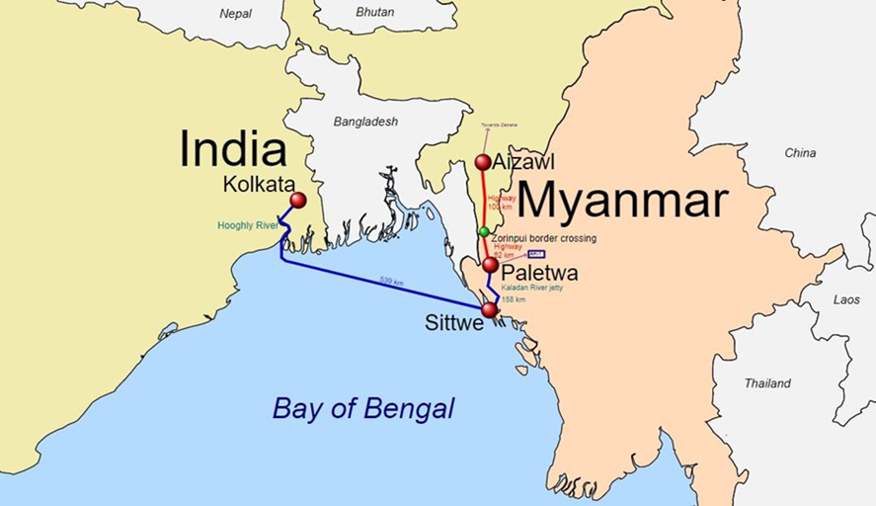
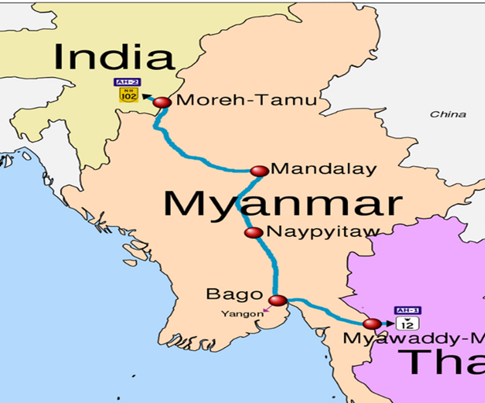
Connectivity Projects
Kaladan Multi Modal Transit Transport Project
India-Myanmar-Thailand Trilateral Highway
India-Bangladesh Protocol on Inland Water Transit & Trade
Agreement : Chattogram & Mongla Ports , & Matarbari (!)
BBIN Motor Vehicles Agreement
Restoration of Pre-1965 Railway Links with Bangladesh
Akhaura – Agartala Cross-Border Railway Link
Upgradation of the Rih -Tedim Road in Myanmar
Transit Agreements with Bhutan & Nepal for the use of Indian Territory including Fulbari Corridor and Gelephu-Kokrajhar Railway line

Slide 18
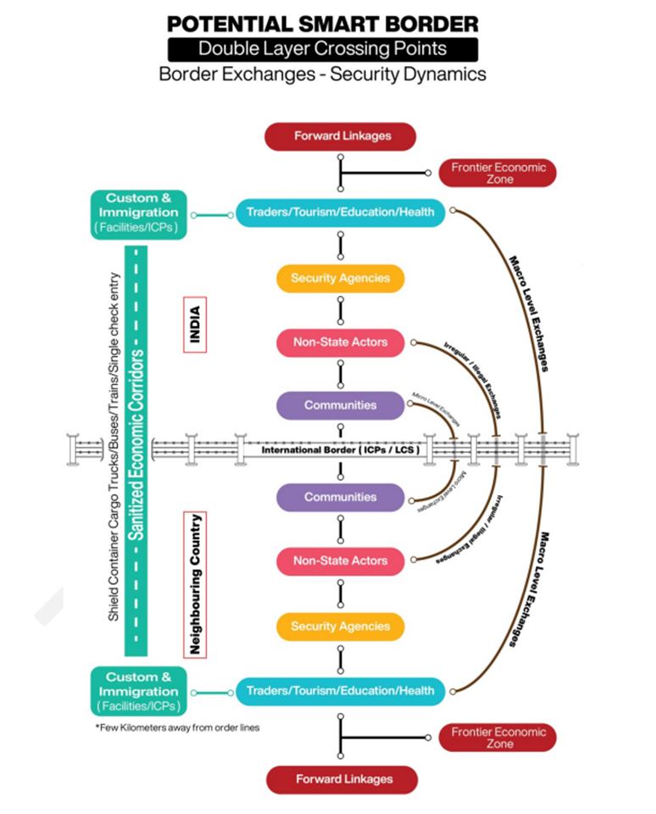

Slide 19
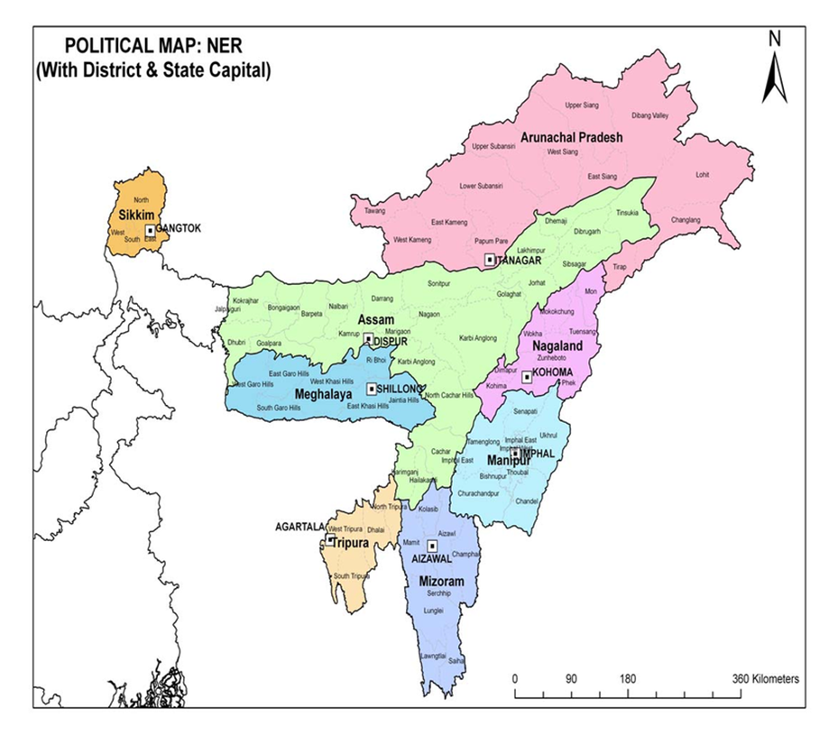
Emerging Alternatives to Chicken Neck
Sittwe Port: Kaladan River
ii) Fulbari Corridor (Bangladesh/Bhutan/India/Nepal junction)
Make use of Chittagong, Mongla and Matarbari deep sea port by Bhutan and Nepal. Access to North East Region through Bangladesh,
iii) Gelephu- Kokrajar Railway line and connecting to Land and Waterways
iv) Newer Corridor Pangsau Pass (Arunachal Pradesh-Myanmar); Bletting-Trashiyangshe (Arunachal-Bhutan); Chewabhanjyang (West Sikkim-Eastern Nepal)
v) Connectivity to operationalise India's Act East Policy
All these complement and consolidate five operational priorities under the SASEC operational plan 2016-2025 of the ADB that focus on this sub-region including Asian Highways and Asian Railways

Slide 20
To develop NER as a source of nature and biodiversity based green products
Organic Farming
Sustainable Forestry & Agroforestry
Renewable Energy
Eco-tourism
Handicrafts & Textiles
Sustainable Fisheries & Aquaculture
Traditional Medicinal Systems
Nature based tourism services
Green Transport
World Heritage List of UNESCO

Slide 21
At present
Indigenous farming practices
1.73 lac ha under Organic Farming
MoA & FW : “Mission Organic Value Chain Development for North Eastern Region.
By 2047.
Organic and Natural Farming area : 1.73 lakh ha in 2022 to 16 lakh ha by 2047
Organic production
0.2 MT (2023) to 3.75 million tonnes (2030) and 15 MT (2047)
Organic farmers households 1.8 lakh (2023) to 10 lakh (2047)
Region’s organic Food Share in the country 7% (2023) to 25-30% by 2047
Subsectoral Indicators
17.5 lakh ha under cereals, productivity of 3.5 t/ha, potential output 61.25 lakh tonnes
7.55 lakh ha under horticulture crops, productivity of 10 t/ha, potential production 75 lakh tonnes
Production of Spices (Turmeric, Ginger, Chili, Cardamom, Pepper, Cinnamon etc) : 10.0 lakh ton

Slide 22
CRITICAL POLICY MEASURES
2025-2030 : 3.50 Lakh ha
2030-2035 : 4.50 lakh ha
2035-2040 : 4.50 lakh ha
2040-2047 : 4.00 lakh ha
To Bring :
50-75 % area of shifting cultivation (0.85 m ha) under OF/NF : 6.37 lac ha (2047)
50% % of high-altitude areas i.e., 0.59 m ha : 2.95 lac ha (2047)
50% of mid altitude (0.90 m ha) : 4.50 lac ha (2047)
10% of foot hills and low altitude areas (0.30 m ha) : 30,000 ha (2047)
04

Slide 23
Goal 4: New Growth Pole : NE Economic Corridor
To develop a futuristic network of state-of-the-art logistics and infrastructure for facilitating trade between NER, rest of India and neighbouring countries and improve further the relation between countries, etc
5 strengths of NER- Society, Economy, Natural Resources, National Security and Bridge Head to South-East Asia
98 percent of borders with Neighbouring countries; less than 1 % share in national exports
2047 Goals
NER Growth Quadrangle (NERGQ) to contribute 8 percent (US $ 2.8 trillion) of the national GDP (US $ 30 trillion) by 2047.
Export Growth Expectancy: A growth rate of 7% to 20 % is expected by 2047
Export Value Expectancy: NER Exports are expected to reach US $3 billion by 2047
NER economic corridor : significant economic growth, regional integration, enhanced trade, increased investment, job creation, and an overall socio-economic development

Slide 24
Frontier Economic Zones in the Border Areas : New Mountain Ports
Recognising the new development frontiers away from both the nature and contents Special Economic Zones and Sea Ports of the Coastal Areas
Four Zones:
i) Exclusive Production Supply zones : Pharmaceuticals
ii) Interconnected Production Supply zones (Raw materials and other inputs on a transborder basis)
iii)Cross Regional Zones : Supply and value chains like tourism
iv)Transborder Service exchanges Zones : educational facilities, hospitals, communications and energy

Slide 25
Value Chain Example : Turmeric
In the case of Manipur, Meghalaya, and Mizoram the traders are generally from Assam and in the case of Sikkim the wholesale traders are from the North Bengal areas of West Bengal.

Slide 26
HEALTH DAM FOR IMMIGRANTS-
Borderland Health Campus
THE CONCEPT
State-of-the-art hospital will be built in borderland shared by two countries and connected to India’s neighbourhood connectivity projects including land, railway, airport and waterways
Modern Socio-economic amenities available to all visitors
Treatment, Recuperation and Back to home country
Securitized-dedicated corridor would be laid out
Single entry-exit point corridor for both Indian and foreign nationals
Visa free entry with passports (for Myanmarese and Bangladeshis) and permitted Identity proofs for Nepalese and Bhutanese nationals
Limits of Movements : within the campus
Common currency hospital with INR for conversion
Banks will issue Indian debit cards for exclusive use in the hospital campus

Slide 27
PROPOSED LOCATIONS
Dawki in Meghalaya (for Bangladeshi nationals)
Pangsau in Changlang in Arunachal Pradesh (for Myanmarese nationals)
Kokrajhar in Assam (for Bhutanese nationals)
Uttaray (Chewabhanjyang) in West Sikkim (for Nepali nationals)
BROAD BENEFITS
Easy access to the state-of-the art Indian hospital and medical facilities, affordable and comfortable options
Cultural and Social assimilations, goodwill nurturing, confidence and trust building with neighbours
Economic and social integration at the bilateral and sub-regional levels, decline in illegal migrations
Optimal use of connectivity projects, major new source of income and employment
Decline in the Indian visa applicants in a country like Bangladesh
Creation of new connectivity projects
Steady fall in travel to distant destinations

Slide 28
New Development Partners :
Critical Resources, Technology, Production and Market Linkages
Externally Aided Ongoing Projects Details (Rs Crore)
 | ADB | JICA | WB | KFW | IFAD | NDB | AIIB | AFD | Total
Tripura | 3222.4 | 713.39 |  | 345.22 |  |  |  |  | 4281.01
Sikkim | 864.86 | 312.6 |  |  |  |  |  |  | 1177.46
Nagaland | 4 | 361.36 | 1551.32 |  | 334.07 |  |  |  | 2250.75
Mizoram | 1860 | 560 | 491.43 |  | 292.99 |  |  |  | 3204.42
Meghalaya |  | 922.8 | 1538.15 | 1337.99 | 170.81 |  |  |  | 3969.75
Manipur |  |  |  | 123.89 |  | 5031.28 |  |  | 5155.17
Assam | 8716.43 | 6654.73 | 8849.75 |  |  | 4837.77 | 10762.07 | 416.01 | 40236.76
Source: MDoNER, Govt of India

Slide 30
Goal 5: Climate Neutral NER
Collect, collate and analyze meteorological data to ascertain climate shift pattern in the region
Drone/Satellite imagery mapping of climate vulnerable areas
Assess per person and per hectare emission of carbon and other green house gases and strategies their minimization.
Similarly assess methane emission from livestock and take reduction measures
Adopt already validated climate adaptation technologies, methods and methodologies, packages and practices to minimize the impact of climate change.

Slide 31
The Idea
Comprehensive Natural and Comparative advantages in terms of traditional medicinal systems, bio diversity hot spots and abodes of mountain deities and destination of for medical, adventure tourism and war relics tourism.
The Ethno Medicine and Tourism Commission (EMTC) : regional level
Mode : PPP, exclusively for commercializing the ethno-medicinal practices and extending further to promote wellness and medical tourism.
The AYUSH Ministry, Central Universities in the NER, North Eastern Institute of Folk Medicine at Pashighat and the MDoNER would coordinate the entire architecture and building of the EMTC.
Tourist Arrivals (2022) : 118.45 lakh domestic and 1.04 lakh foreign tourists
By 2047.
Total Arrivals expected to reach 20-25 million
8-10% GSDP contribution from tourism sector in NER
TMS , Health-bio diversity- adventure- war relics tourism products attract global and domestic tourists

Slide 32
Strategic Moves & Policy Interventions
EMTC : galvanise confluence of seven critical elements in a single regional platform.
Folk medicine practices : mobilization of faith healers and their knowledge bases
Natural resources including scientific data base of plants, herbs and other natural substances
TMS practices to testing laboratories of University/ Research Institutes
Providing Patents and IPRs to these practices and knowledge base designs
Cognisance and adoption by industrial and corporate houses leading to commercial scale production
Commercial marketing at the national, regional and global markets and
Payment back to the faith healers, communities and the states

Slide 33
VISION TARGET Repositioning NER in India’s Tourism Map
Area | Current Share in India | Target by 2047
Total Tourist visitation in the region | 9.9 million (2019) | 20 - 25 million
Domestic Tourist Visit | 0.41% | 5-10%
Foreign Tourist Visit | 1.17% | 10-15%
GSDP contribution of Travel & Tourism in the region | 1.55% (as per 2019 statistics) | 8-10%
Accommodation inventory | 1 lakh rooms | 5 lakh rooms
Tourism Competitiveness Rank - Foreign Tourist Arrivals | 1 NER State in Top 20 | 4 NER States in Top 10
Tourism Competitiveness Rank - Domestic Tourist Arrivals | 2 NER State in Top 30 | 5 NER States in Top 20

Slide 34
To develop NER into a thriving hub of Soft Power : Youth, Sports, Music, Food and other Entertainments would globalize the locals and bring newer vistas of development and change.
Demonstrative potentials
NER has 4 % of the youth population of the nation
Endowed with inherent talents in sports, music, art, food and other cultural domains.
Evident in the performance and achievements in Olympic Games, Asian Games, Commonwealth Games, International Film and Art Festivals.
With institutional mechanisms, these talents can be
# Monetised # Industrialised # Deployed as soft
power tools in implementing the Act East Policy and Foreign Policy
Vision for 2047
Expansion of sports , music, food and entertainments infrastructure
Professional training and newer technology induction
Community mobilsation
Bring national and international institutions
10 more UNESCO Heritage sites in the NER in addition to the present four sites.

Slide 35
YOUTH MISSION 2047 : OVER 100 SCORES STRATEGY
100 international sports persons including for the World Championship, Olympic, Asian and Commonwealth Games
100 IAS, IFS, IPS Officers ; 100 IES, ISS & Forest Service officers
100 National and international musicians, film makers, fashion designers, architects
300 PhDs from the top professional institutes from IIM, IIT, NIIT, IIIT, NIFT, IISc, IIMC
100 Top medical practitioners and bankers
100 Top Civil Society Actors and Community Leaders
100 Top Media Professionals and Academics
100 Top entrepreneurs and Start ups
100 Top Scientists, Technocrats and Innovators
100 Brigadiers, Commodore and Air Commodore.
100 Graduates from FTII-Pune, NSD-Delhi and other film academies
1
NER : one of the highest youth populations in the country
2
Attractive traits like naturally talented, fast learners, strong family and societal bonds, quicker adaptability, largely English speaking, creative and innovative and higher degree of sociability and cultural assimilations.
3
New generation of youths has developed entrepreneurial ability, outward looking attitude, competitive fervor and modern skills remarkable performance in sports, music, fashion, media and civil society actions.

Slide 36
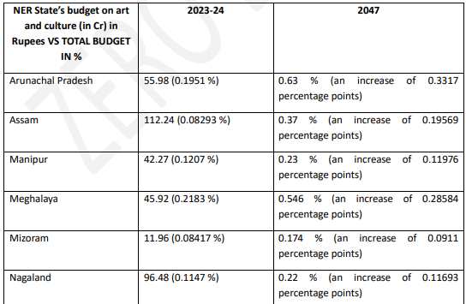
Investment in Sports Investment in Music as a Soft Power

Slide 37
Goal 8: The Peace Dividend 2047
Conflict driven instabilities have been a reality in the NER
Cost of Conflicts and instabilities have been high and damaging.
If one stood in a place like Guwahati, within 700 kms perimeter one could find all varieties of global conflicts.
No single and compact geographical region has recorded
Except the nuclear war, one can name any genre of conflicts in the NER.
Last 15 years : sharp decline in both Conflicts and Killings : Range of Peace Accords signed and huge gains from stabilities
To develop NER as a citadel of peace and tranquillity that would trigger and accelerate growth in all fields.
Examples of Peace Dividend : Vietnam, Japan and others with similar geography, ethnicity-communities, cultural ecology
This will in turn ensure human, national and environmental security
Demonstration effect in other conflict affected regions

Slide 38
PEACE DIVIDENDS AND SDG ACHIEVEMENT CAPITAL OF INDIA
Peace and Conflicts in the NER :
Assam : Cost of Conflicts : Declining Phenomenon
Peace Dividend : Multi-dimensional Poor Headcount Ratio 2023
Year | Incidents of Killing | Civilians | Security Forces | Terrorists/Insurgents/Extremists | Not Specified
2000 | 224 | 267 | 37 | 223 | 7
2005 | 113 | 130 | 8 | 82 | 13
2010 | 103 | 45 | 12 | 97 | 0
2015 | 46 | 11 | 1 | 49 | 0
2020 | 7 | 3 | 0 | 5 | 0
2023 | 5 | 3 | 0 | 5 | 0
Total | 2590 | 2227 | 340 | 2362 | 150
States | Headcount Ratio (%) | National Position among 28 States
Arunachal Pradesh | 13.76 | 18th
Assam | 19.35 | 23rd
Manipur | 8.10 | 13th
Meghalaya | 27.79 | 26th
Mizoram | 5.30 | 7th
Nagaland | 15.43 | 20th
Sikkim | 2.60 | 4th
Tripura | 13.11 | 17th
India | 14.96
Assam : Annual Fatalities 2000-2024

Slide 39
How Peaceful States made increasing contributions to the Shares in the GDP of North East Region
State | 1980-81 | 1990-91 | 2000-01 | 2010-11 | 2020-21 | 2022-23 | Geog Area (sq km)& share total
Arunachal Pradesh | 106.68 (2.99) | 507.69 (3.36) | 1787 (3.12) | 9021 (5.09) | 30547.81 (5.20) | NA | 83,743 | 31.9
Assam | 2516.26 (70.55) | 10620.66 (70.34) | 36814.16 (64.22) | 112688 (63.63) | 353605.42 (60.14) | 493166.6 (75.73) | 78,438 | 29.9
Manipur | 218.42 (6.12) | 820.59 (5.43) | 3111.7 (5.43) | 9137 (5.16) | 29776.09 (5.06) | NA | 22,327 | 8.5
Meghalaya | 200.32 (5.62) | 889.51 (5.89) | 3960.94 (6.91) | 14583 (8.23) | 33776.16 (5.74) | 42697.08 (6.56) | 22,429 | 8.6
Mizoram | 68.07 (1.91) | 340.84 (2.26) | 1737.42 (3.03) | 6388 (3.61) | 23922.94 (4.07) | NA | 21,081 | 8.0
Nagaland | 118.97 (3.34) | 655.07 (4.34) | 3399.3 (5.93) | NA | 29831.64 (5.07) | NA | 16,579 | 6.3
Sikkim | 52.07 (1.46) | 233.94 (1.55) | 1013.69 (1.77) | 7412 (4.19) | 33017.83 (5.62) | 42756.17 (6.57) | 7,096 | 2.7
Tripura | 285.86 (8.01) | 1030.98 (6.83) | 5499.19 (9.59) | 17868 (10.09) | 53504.12 (9.10) | 72635.62 (11.15) | 10,491 | 4.0
Total | 3566.65 | 15099.28 | NA57323.87 | 177096.32 | 587982.01 | 651255.47 | 262,184 | 100
India | 117488 | 410747 | 1925017 | 7248860 | 20166117 | 23606446 | 32,87,263

Slide 40
NEW INSTITUTIONAL ARCHITECTURE 2047
01
National Act East Commission headed by the Prime Minister
Key instrument of Reverse Integration and Vision 2047 Implementation
NAEC Oversee - Operationalisation of the NER Vision 2047
Provide broad strategic operational road map and policy guidance for the region.
Members : Cabinet Ministers and Secretaries of core Central Ministries;
Chief Ministers and Chief Secretaries of the NER states and
Vice Chairman of NITI Aayog, National Security Adviser, Secretaries of MDoNER and NEC
Eminent professionals, academics, noted civil society actors and community leaders will be the members.
Several options of redesigning the institutional architecture to attain these vision goals.
Suggested Out-of box designing of institutional architecture

Slide 41
During Golden Jubilee Celebration of NEC on 18th December, 2018
Hon’ble Prime Minister’s Vision for North East
HPM Narendra Modi has visited NER 0ver 65 times during 2014-2023
As Gateway to South East Asia
The Asht Lakshmi
“Northeast is our gateway to South -East Asia and can become a centre for development of the entire region.”
Asht Lakshmi (8 states of the region) government should work on 8 foundation pillars for its development, viz. Peace, Power, Tourism, 5G connectivity, Culture, Natural farming, Sports, Potential
Development through Connectivity
In last 8 years, number of airports in the region has jumped from 9 to 16, and the number of flights have increased from about 900 before 2014 to around 1900. Many North Eastern states have come to Railway map for the first time and efforts are being done to expand the waterways also. The length of national highways has increased by 50% since 2014 in the region

Slide 42
PROGRESS SO FAR & WAY FORWARD
Diverse Stakeholders consultations on Draft Document
PROGRESS SO FAR
Submission of Zero Draft (10th May 2024)
2 days Workshop at NEC (16th and 17th May, 2024)
Draft presentation to the Hon’ble Minister of the MDoNER (12th July 2024)
1st Sept-30th September 2024
Revisions and Finalization of Vision 2047
1st October-15 October, 2024
Signing of the Vision 2047 Document
by the Hon’ble Chairman of the North Eastern Council,
Hon’ble Minister of MDoNER and the Chief Ministers of the North East Region
October 2024
Launching of the Vision 2047 by Hon’ble Prime Minister of India
November 2024

Slide 44
THANK YOU

